Slide 1


ICASSP 2022
Paper ID: 5513
Probabilistic Fine-grained Urban Flow Inference
with Normalizing Flows
Presenter: Haoyang Yu
Authors:
Ting Zhong, Haoyang Yu, Rongfan Li, Xovee Xu*, Xucheng Luo, Fan Zhou
University of Electronic Science and Technology of China
1
Notes:
1

Slide 2

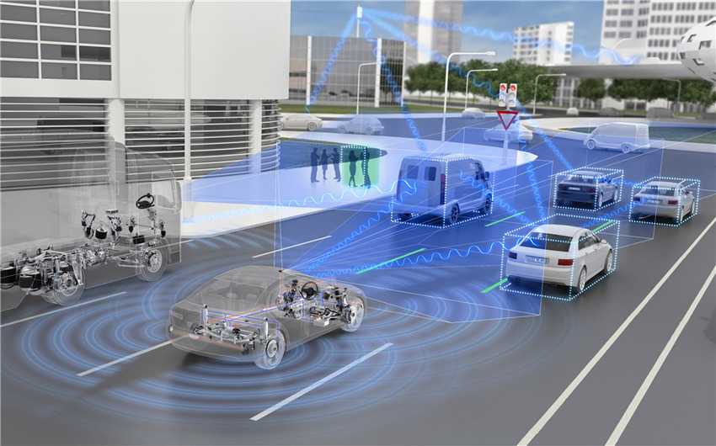
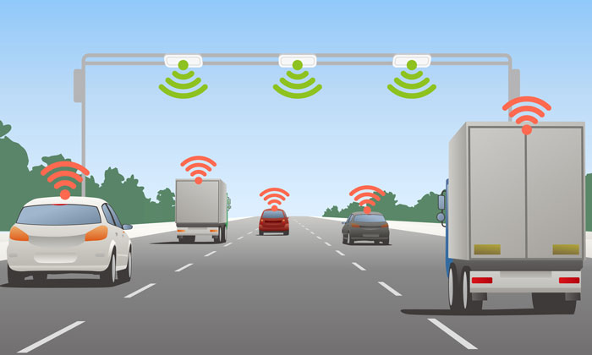

Research Background
Rapid development of Intelligent
Transportation System (ITS) in the world
Deploying sensors in the city will cost
a lot of manpower and energy
How to reduce such expense?
Probabilistic Fine-grained Urban Flow Inference with Normalizing Flows
2
Notes:
2

Slide 3


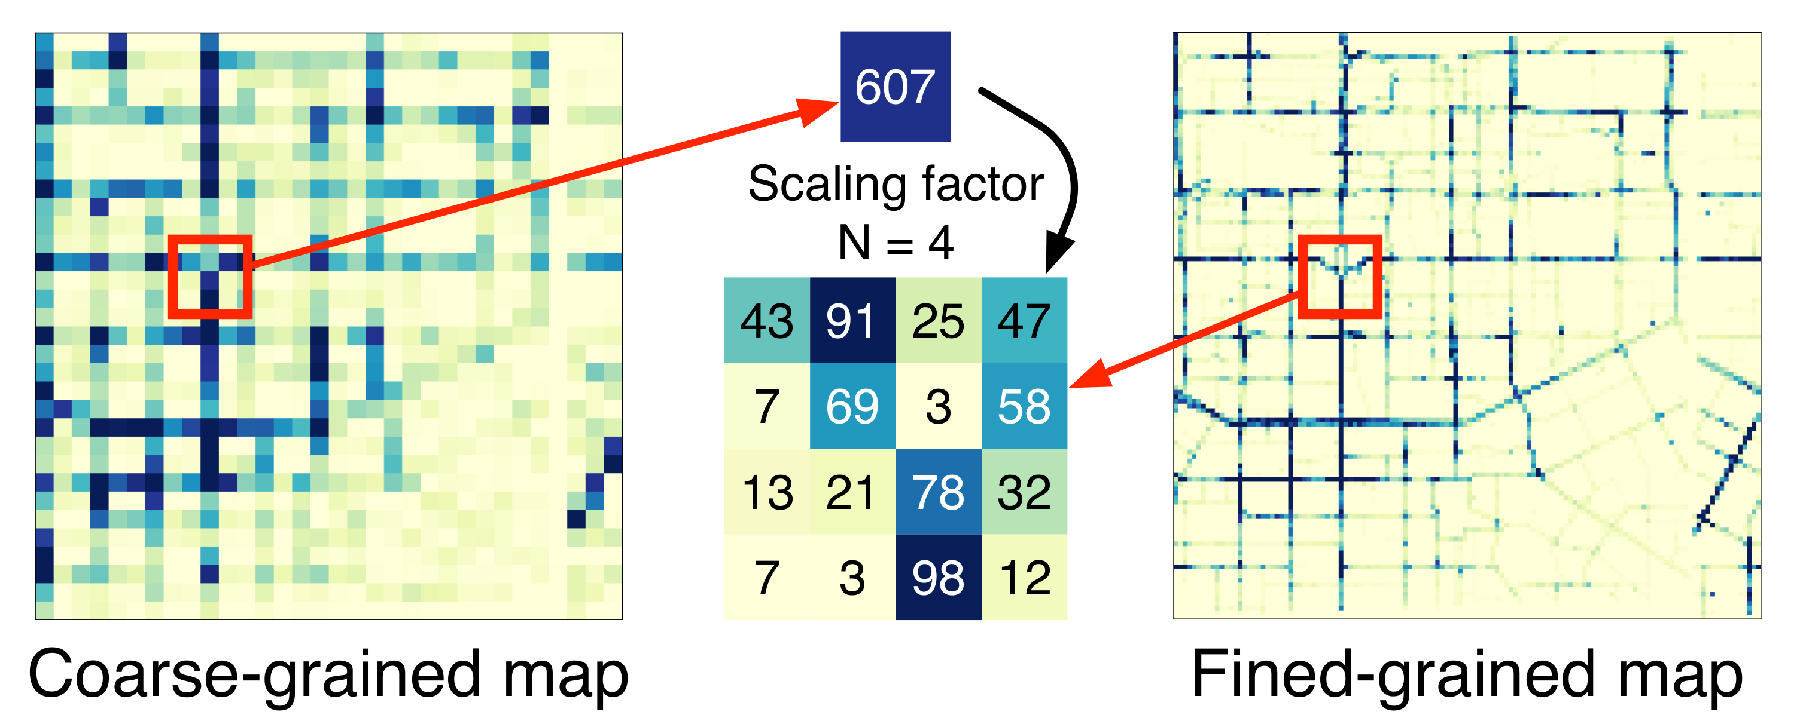


Challenges
structural constraints between coarse- and fined-grained map
Influences of the external factors
(e.g., weather conditions , temperature)
Probabilistic Fine-grained Urban Flow Inference with Normalizing Flows
3
Notes:
3

Slide 4
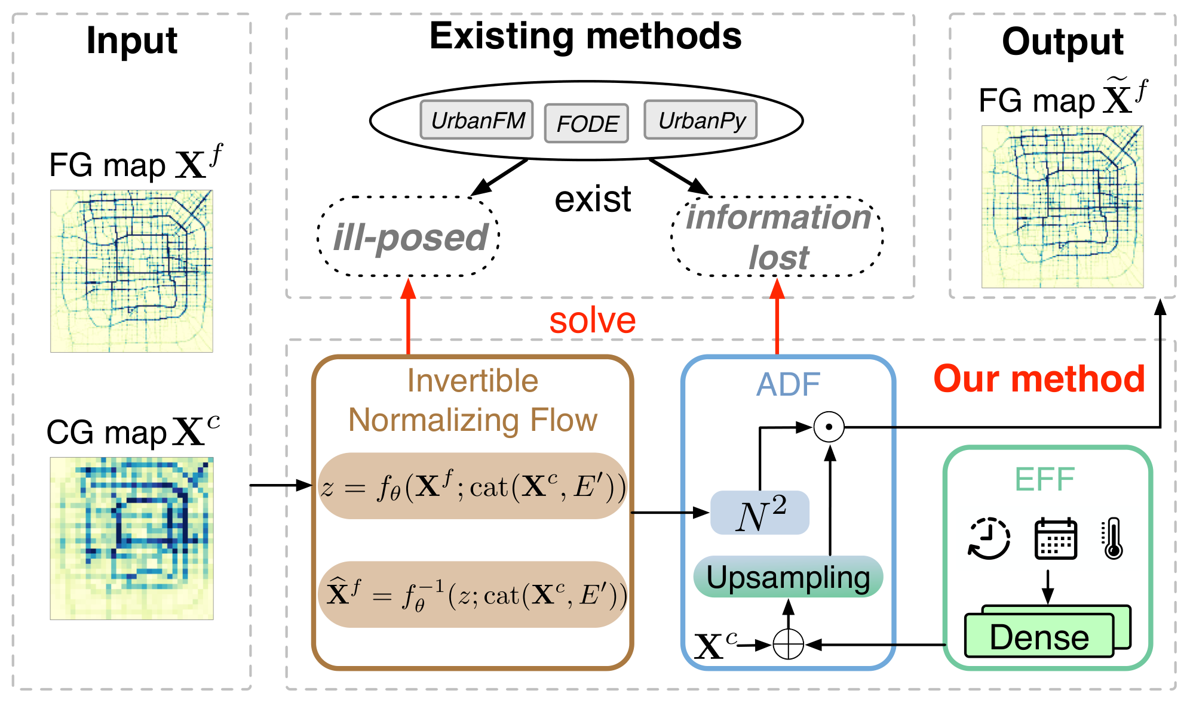
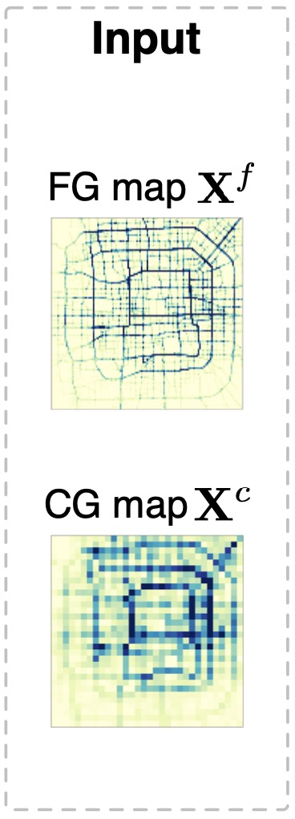
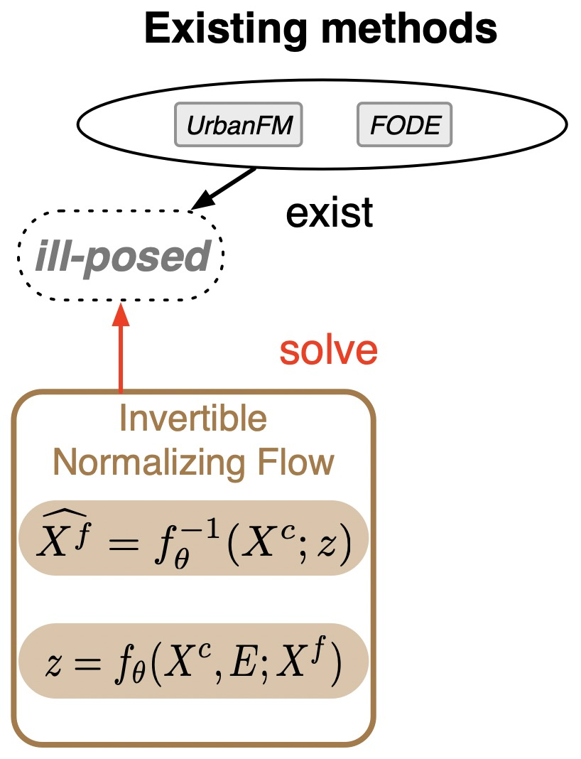
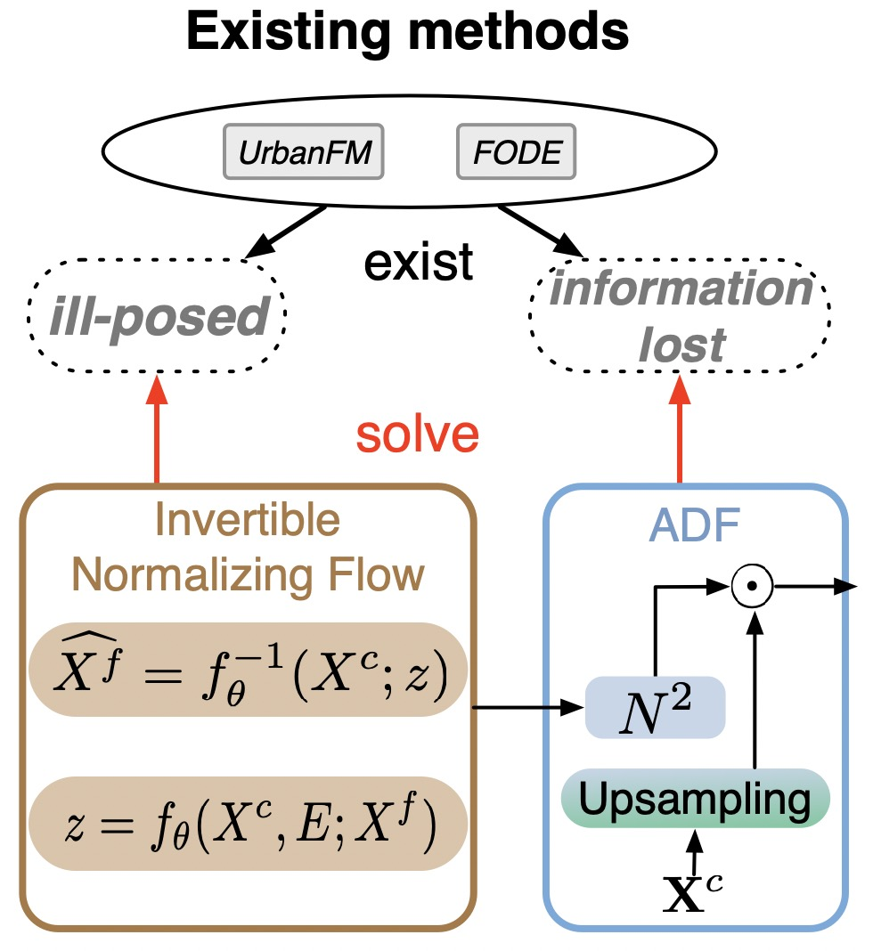

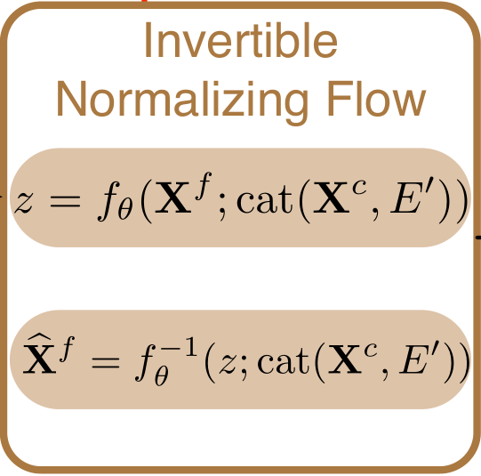
Framework
Probabilistic Fine-grained Urban Flow Inference with Normalizing Flows
4
Notes:
4

Slide 5
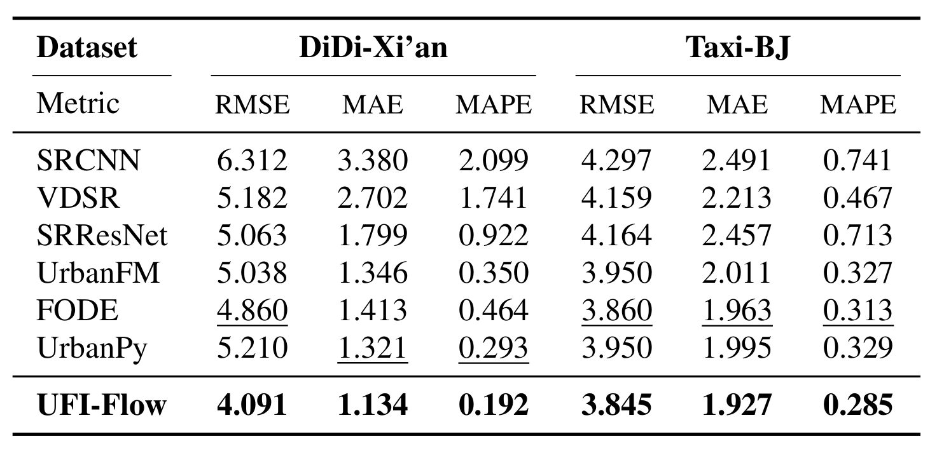
Results
Overall inference performance comparison
Probabilistic Fine-grained Urban Flow Inference with Normalizing Flows
5
Notes:
5

Slide 6
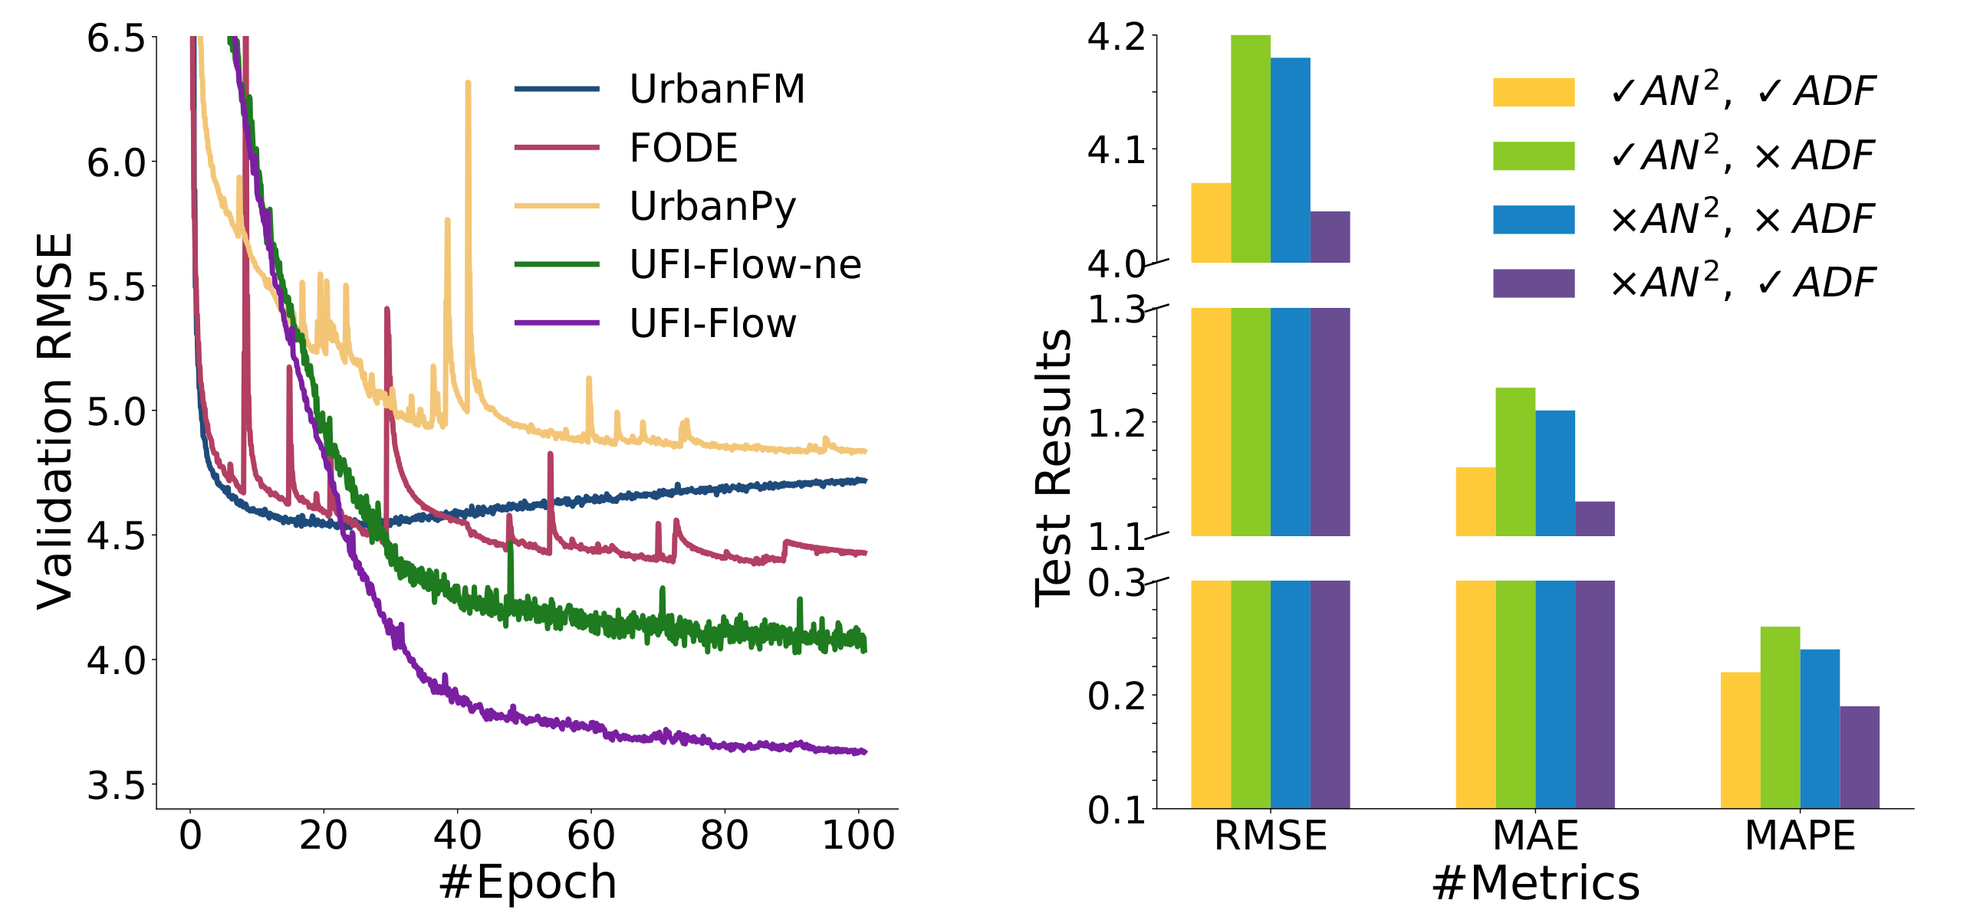
Results
Training process and ablation studies
Probabilistic Fine-grained Urban Flow Inference with Normalizing Flows
6
Notes:
6

Slide 7
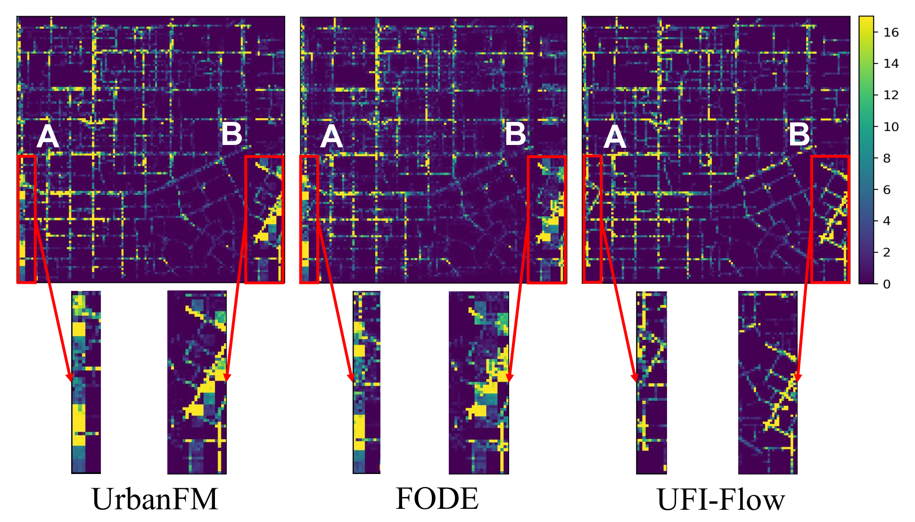
Results
Error visualization on the dataset
Probabilistic Fine-grained Urban Flow Inference with Normalizing Flows
7
Notes:
7

Slide 8
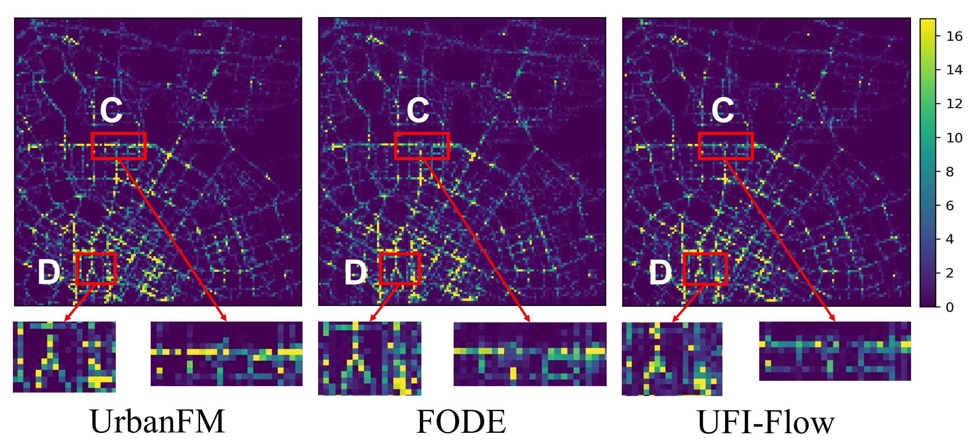
Results
Error visualization on the dataset
Probabilistic Fine-grained Urban Flow Inference with Normalizing Flows
8
Notes:
8

Slide 9
ICASSP 2022
Paper ID: 5513
Probabilistic Fine-grained Urban Flow Inference
with Normalizing Flows
Presenter: Haoyang Yu
Thank you!
9
Notes:
9

